Slide 1

Class 9 – Support Vector Machines (SVM) Regression
Pedram Jahangiry
Fall 2019

Slide 2
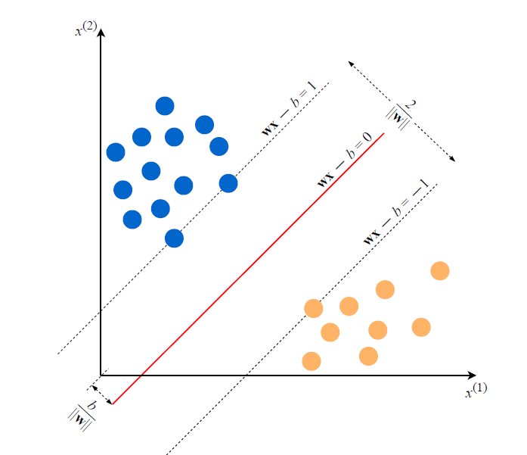
Support Vector Classification (SVC)
Notes:
Why, by minimizing the norm of w, do we find the highest margin between the two classes? Geometrically, the equations wx−b = 1 and wx−b = −1 define two parallel hyperplanes, as you see in Figure above. The distance between these hyperplanes is given by 2/||w|| (remember the perpendicular distance from a line is equal to |f(x)| / || w ||
So maximizing the margin = minimizing the || w || or any monotone function of that.

Slide 3
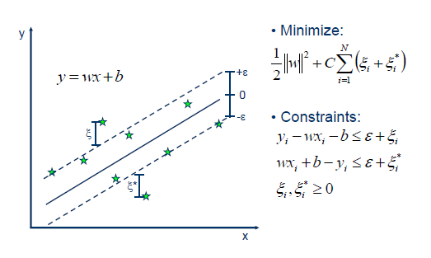
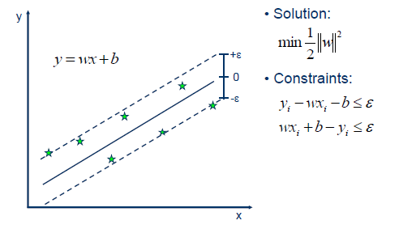
Support Vector Regression (SVR)
Minimize:
Notes:
This is like SVM but on the vertical axis we have y.
Note that C is our cost function. Bigger C end up having narrower margin (less bias and more variance) or overfitting.

Slide 4
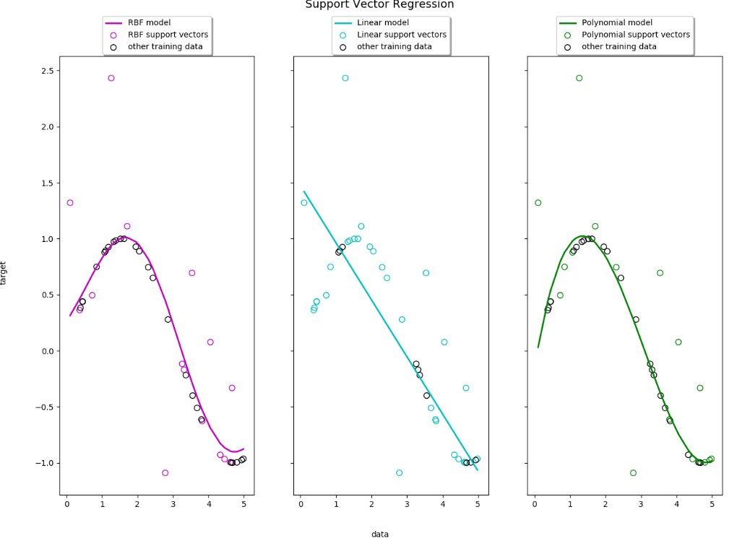
Notes:
Since we have polynomial regression (with interpretations as well) we usually don’t use SVM as regressors.
The dots are discolored here in the legend.

Slide 5
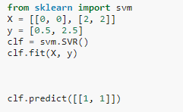

SVR in Python
Find the SVR Sklearn documentation here
Blackbox version of SVR in python:

Slide 6
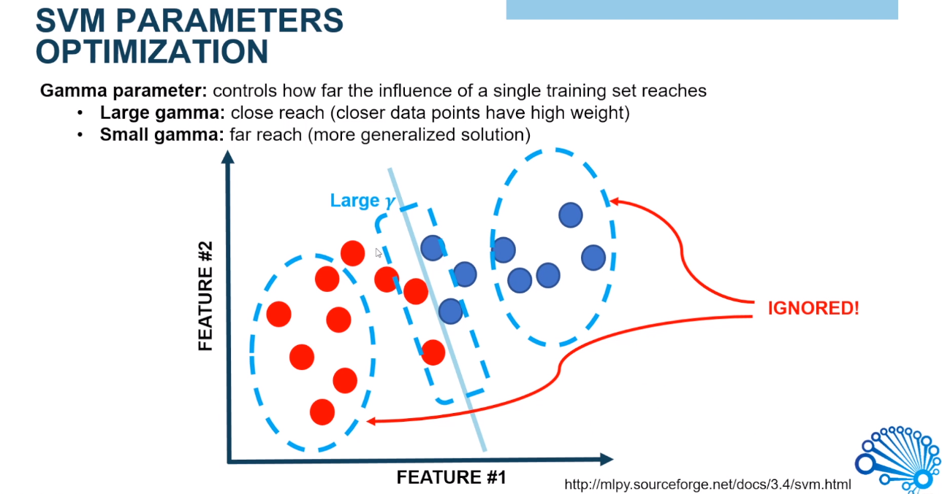

Slide 7
